Slide 1
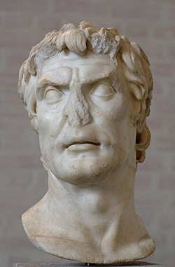
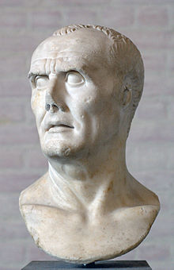
REVISION 4
EST PREPARATION
Week 4, Lesson 4

Slide 2
EST REVISION - Overview
WEEK | Tuesday | Wednesday | Thursday | Friday
3 | X | X | X | Revision 1
4 | Revision 2 | Revision 3 | Revision 4 | Revision 5
5 | EST | Inquiry | Inquiry | Inquiry
6 | Inquiry | Inquiry | Inquiry | Inquiry

Slide 3

Today’s Lesson
Question 5

Slide 4
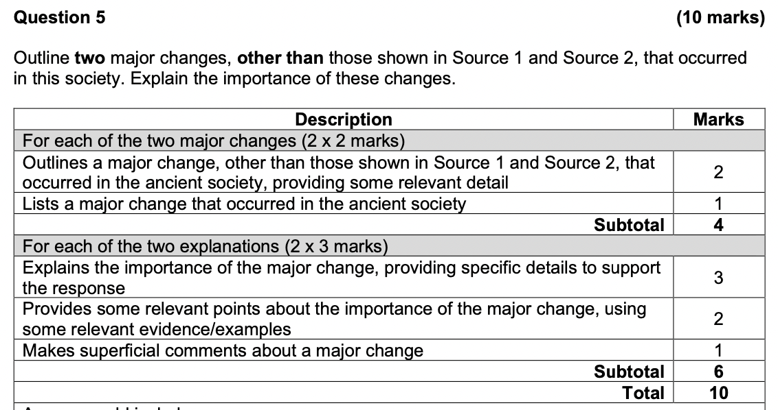
Question 5

Slide 5
Question 5 – How to answer

Slide 6
Sample Answers
Changes to the role of the Tribune, seen where the tribunes become legislators (i.e. Tiberius and Gaius Gracchus), link with generals to pass lex agrarias for the generals’ veterans (i.e. Saturninus 102 BC) or pass extraordinary commands through the assemblies (i.e. Gabinius 67 BC) et al.
The further growing power of the Tribunes, who also began to involve themselves in such areas as foreign affairs, extraordinary commands, links with military commanders, citizenship etc. This significantly empowered their role and influence in Roman politics and helped to undermine the authority of the Senate.
Marius’ reforms to the Roman army made it better: stronger, fitter, faster and better equipped. His reforms paved the way for the extension and maintenance of the empire for the next centuries.
Marius’ new army had given its loyalty to Marius instead of the Senate (as hinted in Source 2). It facilitated the transition to a situation when commanders would use their armies as their own private forces. For example, Sulla’s march on Rome in 88 BC and Pompey’s threats to march his legions on Rome during the 70s BC. It also resulted in the series of Civil Wars that destroyed the Republic by 27 BC i.e. Sulla vs Marians 84–82 BC, etc.
Extraordinary commands changed from being unusual to regular. For example, in the years 104–100 BC, Marius was elected to an unprecedented succession of consulships every year to deal with the threat from the Celts/Germanic tribes who were threatening Italy from the north. This was important because extraordinary commands came to be seen as an essential part of political power and this power was dominated by men who had armies loyal to them.
Reasserting the authority of the Senate. Sulla’s attempt to put the people firmly under the control of the Senate was important because Sulla felt that political power should rest firmly in the hands of the Senate and consequently, he gave the State a single head, the Senate, removing those elements that had threatened its authority.

Slide 7
Practice Source Analysis
Complete the Source Analysis (10 minutes)
We will mark this together as a class

